Slide 1
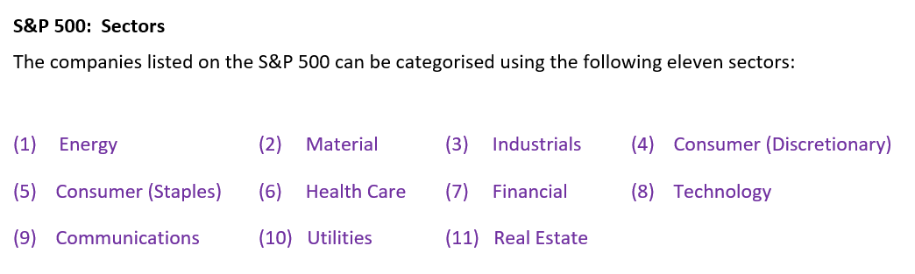
The Recovery Quotient:
QRec
Our group was interested in comparing the recovery times of sectors across DIFFERENT recessions.
RECESSIONS : COVID-19 GLOBAL FINANCIAL CRISIS DOT-COM (and September 11 attack)

Slide 2


The Recovery Quotient:
Using ‘days’ to measure recovery works WELL when comparing sector performance after the SAME recession.
Using ‘days’ to measure recovery after DIFFERENT recessions seemed, to our group, to lack meaning.
To facilitate cross-recession comparison we created the Recovery Quotient (QRec).

Slide 3
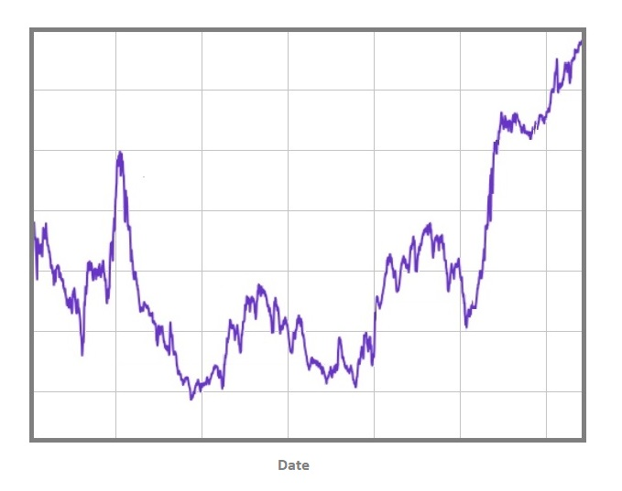

Slide 4
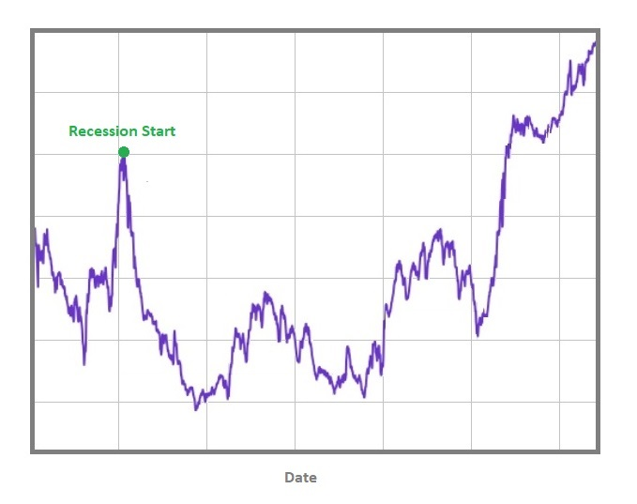

Slide 5
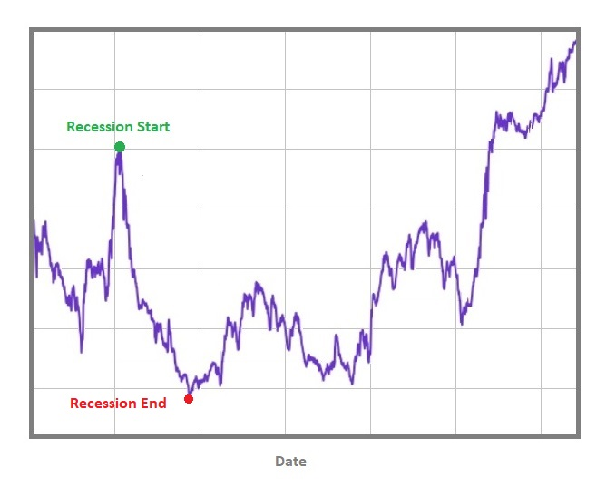

Slide 6
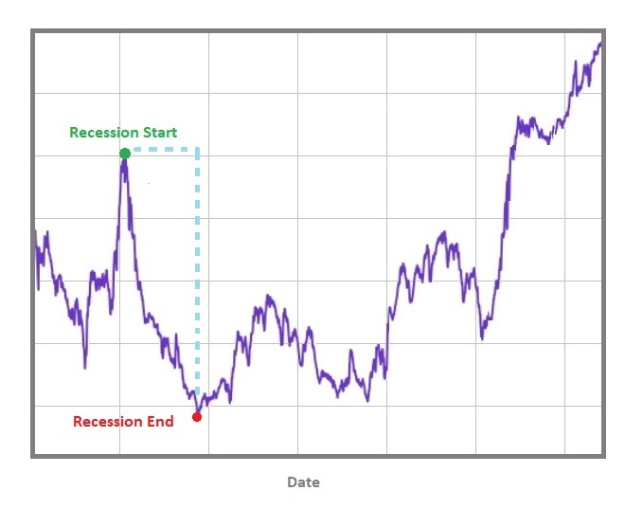

Slide 7
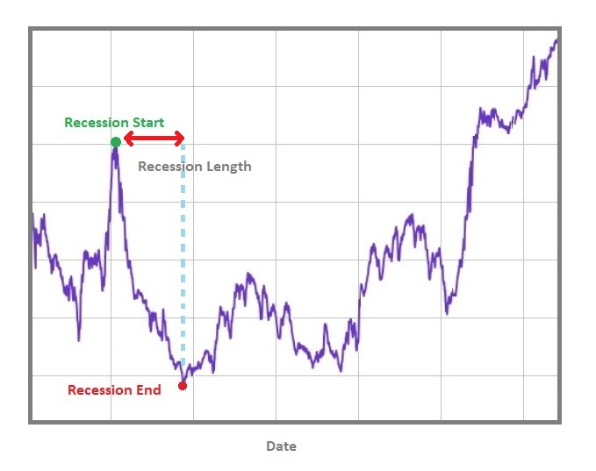

Slide 9
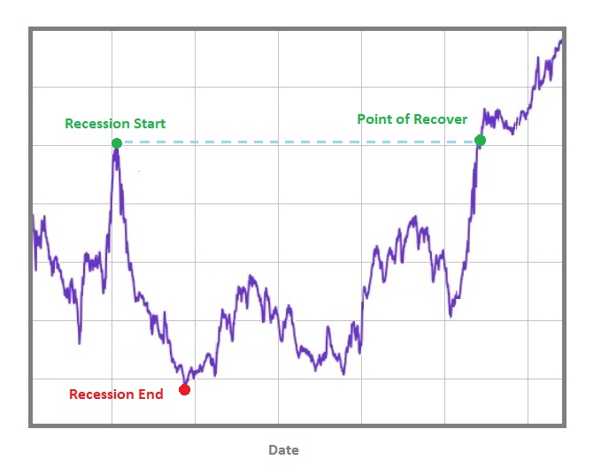

Slide 10
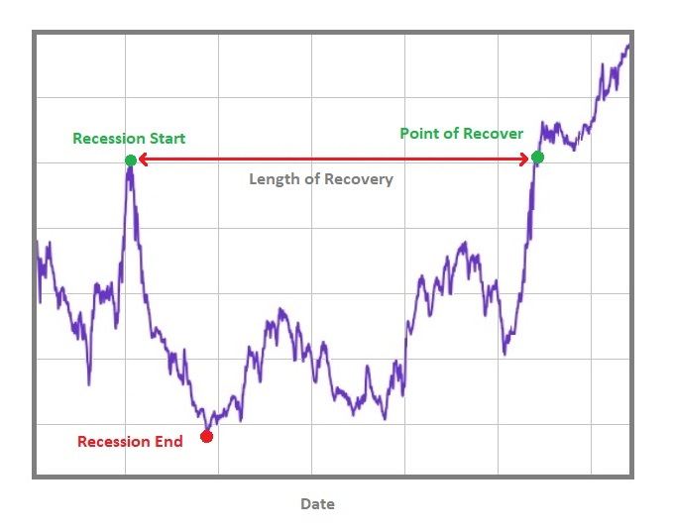

Slide 11

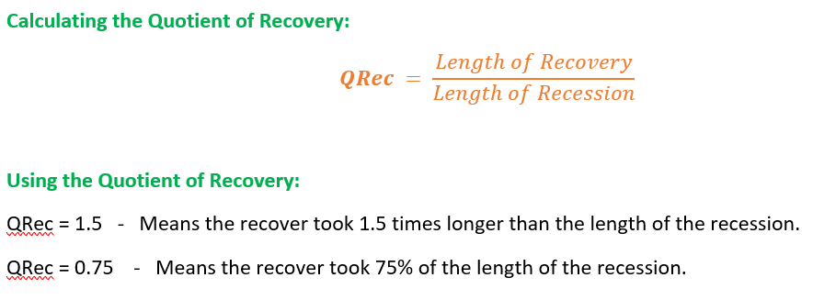
The Recovery Quotient:

Slide 12

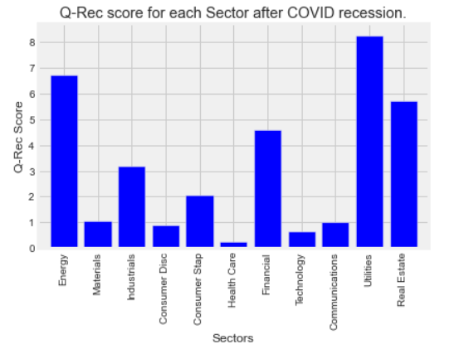
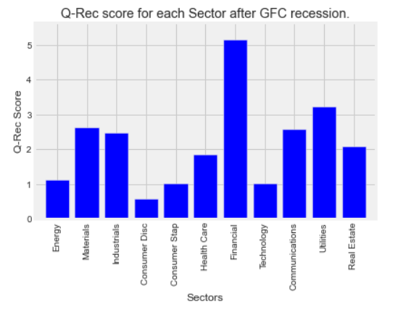
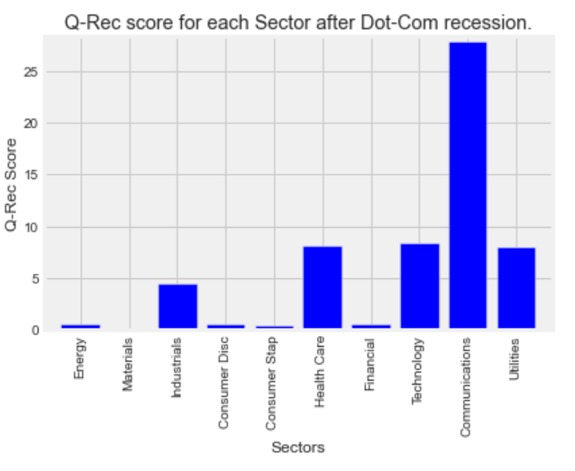
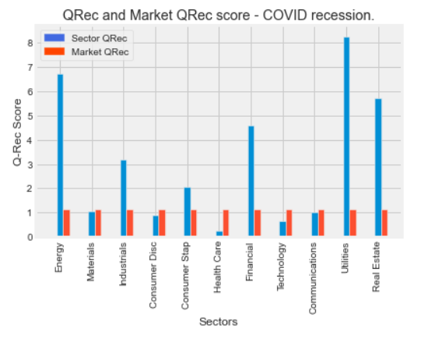
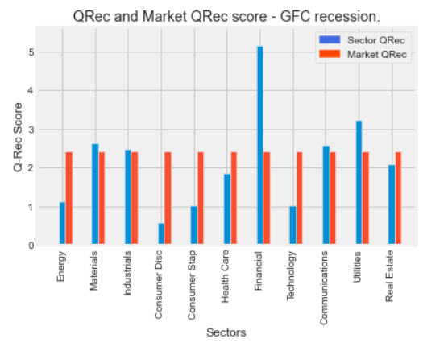
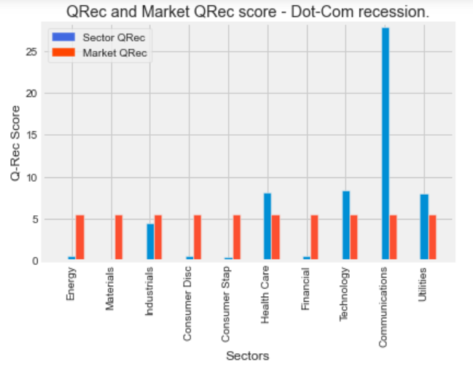
Key Question 1:
Do all sectors take the same amount of time to recover after a recession?

Slide 13
Key Question 2:
Is there a strong link between the number of days a recession lasts for and the number of days it takes for the market and its eleven sectors to recover?
The COVID-19 recession lasted 61 days and took the market 68 days to recover (QRec = 1.11).
The Dot-Com recession lasted 246 days and took the market 1365 days to recover (QRec = 5.54)
The GFC recession lasted a staggering 549 days……
If there was a link what would you predict?
The GFC only required a recovery time of 1327 days (QRec = 2.417).

Slide 14
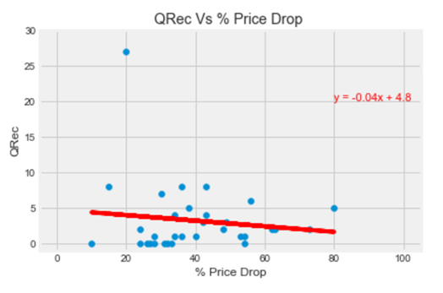
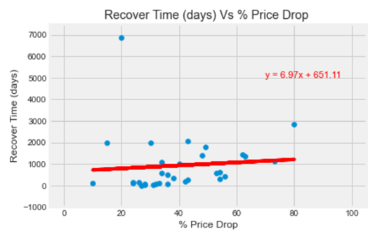
Key Question 3:
Do sectors that experience higher percentage losses during a recession take longer to recover?
r-squared value of 0.007.
r-squared value of 0.016

Slide 15
Limitations
Limited API data:
We could not source pre 2000s data from the Yahoo finance API.
This precluded us from analysing more recessions.
Real Estate sector data did not exist at the time of the Dot-Com recession. This gave us incomplete data for that recession.
Time:
The group would have analysed this data in even greater detail had time not run out.

Slide 16
Key insights
During each of the last three recessions, there is an enormous amount of variation sector recovery times. Sectors recover at different rates to one another.
One might think that a longer recession would mean a longer recovery for both the market and its eleven sectors, but this has not been the case for the last three recessions.
According to data from the last 3 recessions there is no relationship between the loss in value incurred by a sector and the time it takes to recover.

